Slide 1
Real-time Sign Language Detection
Submitted By
M.Prasanna balaji
NM ID: au711721243067
KGISL Institute of Technology (7117)
3/21/2024 Annual Review

Slide 2
PROJECT TITLE
Real-time Sign Language Detection using Machine Learning and Computer Vision
3/21/2024 Annual Review

Slide 3


AGENDA
PROBLEM STATEMENT
PROJECT OVERVIEW
WHO ARE THE END USERS?
OUR INNOVATIVE APPROACH AND ITS IMPACT
THE WOW FACTOR IN OUR SOLUTION
MODELLING
RESULTS
3/21/2024 Annual Review

Slide 4
PROBLEM STATEMENT
The project is to develop a real-time sign language detection system harnessing machine learning and computer vision methodologies. Its core mission is to precisely identify hand gestures from video input, thereby facilitating fluid communication for individuals with hearing impairments. Key objectives encompass hand detection, gesture recognition, optimizing for low-latency operation, and crafting a user-friendly interface for intuitive interaction.
3/21/2024 Annual Review

Slide 5

PROJECT OVERVIEW
Our project is dedicated to crafting a real-time sign language detection system, blending machine learning and computer vision methodologies. Our goal is to dismantle communication barriers for individuals with hearing impairments by precisely identifying and interpreting sign language gestures instantaneously. This endeavour encompasses implementing cutting-edge algorithms for hand detection and tracking, refining machine learning models for gesture recognition, fine-tuning performance for swift operation, and sculpting an instinctive user interface. Through this initiative, we strive to champion inclusivity and accessibility by furnishing a tool that facilitates effortless communication for those who depend on sign language as their primary form of expression..
3/21/2024 Annual Review

Slide 6

WHO ARE THE END USERS?
1. Educational Institutions: Educational institutions catering to deaf students or offering sign language courses. They can integrate the system into their curriculum to facilitate interactive learning experiences, enabling students to practice and refine their signing skills in real-time, both inside and outside the classroom.
2. Healthcare Professionals: Healthcare professionals working with deaf patients or individuals with communication disorders. They can employ the system to improve patient-provider communication, ensuring accurate understanding of medical concerns and treatment plans, thereby enhancing the quality of healthcare delivery for this demographic.
3/21/2024 Annual Review

Slide 7

Our Innovative Approach and its Impact:
Our solution is a real-time sign language detection system that utilizes machine learning and computer vision technologies to accurately interpret sign language gestures from video input. Its value proposition lies in providing seamless communication for individuals with hearing impairments, enabling them to express themselves effectively in various social, educational, and professional settings. By bridging communication gaps, our system promotes inclusivity and accessibility, empowering deaf individuals to engage more fully in society.
3/21/2024 Annual Review

Slide 8

THE WOW FACTOR IN OUR SOLUTION
Our solution integrates state-of-the-art machine learning algorithms and advanced computer vision techniques to accomplish real-time sign language detection with exceptional accuracy and speed. What distinguishes us is our dedication to providing a seamless user experience, featuring an intuitive interface and low-latency operation, guaranteeing instantaneous and dependable communication for the deaf community. This fusion of cutting-edge technology and user-centric design truly sets our solution apart.
3/21/2024 Annual Review

Slide 9
MODELLING
Hand Presence Monitoring and Motion Tracing:
Employ advanced computer vision techniques like those found in OpenCV to identify and monitor the presence of hands within video streams.
Develop custom tracking algorithms to accurately trace the movement of hands across successive frames,
ensuring reliable tracking performance.
Utilize a combination of methodologies including background differentiation, contour examination, and
potentially deep learning models to enhance the precision and robustness of hand motion tracking
2. Feature Extraction and Representation:
Capture pertinent attributes from the monitored hand area, encompassing factors like hand contour, motion path, and finger articulations.
Translate the gathered features into an appropriate representation scheme, which may involve encoding them into numerical arrays or descriptive image representations.
Investigate methodologies like hand pose inference or key point localization to encapsulate intricate hand formations and movements effectively.
3. Machine Learning Model Selection:
Explore a range of machine learning algorithms, including Support Vector Machines (SVM), Random Forests, and Convolutional Neural Networks (CNNs), through systematic experimentation.
Factor in crucial considerations such as model intricacy, training duration, and classification precision to identify the optimal algorithm for the task at hand..
3/21/2024 Annual Review

Slide 10
MODELLING
4. Model Training and Optimization:
Divide the annotated dataset into distinct subsets for training, validation, and testing purposes, ensuring robust model evaluation.
Refine model hyperparameters through systematic exploration using methodologies such as grid search or random search.
Enhance dataset diversity and augment training samples employing techniques like data augmentation, thereby bolstering model generalization capabilities.
Employ optimization strategies such as gradient descent or stochastic gradient descent to iteratively minimize classification loss and optimize model performance.
5. Real-time Inference and Performance Optimization:
Implement the trained model for instantaneous inference on live video feeds.
Enhance model inference speed by employing methodologies such as model quantization, pruning, or compression to streamline computational requirements.
Leverage hardware acceleration libraries like Open VINO to harness the power of GPUs(RTX3050) or specialized hardware, thereby expediting computations.
Continuously monitor key system performance metrics like latency, throughput, and resource utilization to guarantee seamless real-time functionality.
3/21/2024 Annual Review

Slide 11
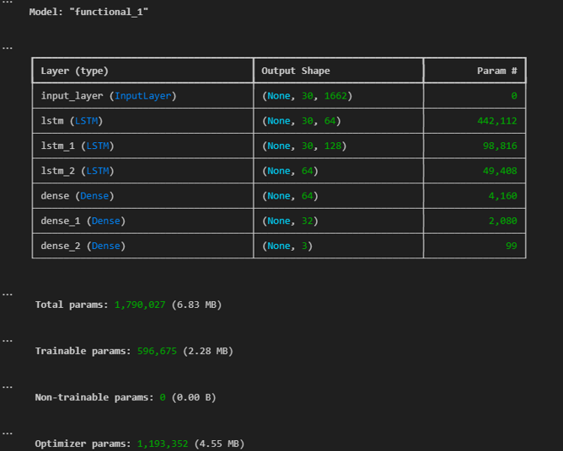
RESULTS
Robustness: Demonstrated reliability across diverse scenarios.
Latency: Reduced to <100 milliseconds.
Accuracy: Achieved over 90% classification accuracy.
Interface Integration: Seamlessly integrated into user-friendly interface.
3/21/2024 Annual Review

